Slide 1
Natural Language Processing DSECL ZG565
Prof.Vijayalakshmi
BITS-Pilani

Slide 2
Session 2
Date – 6th Sep2020
Time – 9 am to 11 am
These slides are prepared by the instructor, with grateful acknowledgement of James Allen and many others who made their course materials freely available online.

Slide 3
Session#2 – N gram Language model
Human word Prediction
Language Models
What is language model
Why language models
N-gram language models
Uni-gram , bi-gram and N-gram
Evaluation of Language models
Perplexity
Smoothing
Laplace smoothing
Interpolation and Back off

Slide 4
Human word Prediction
We may have ability to predict future words in an utterance .
How?
Based on domain knowledge
red blood
Based on syntactic knowledge
the <adj/noun>
Based on Lexical knowledge
baked <potato>

Slide 5
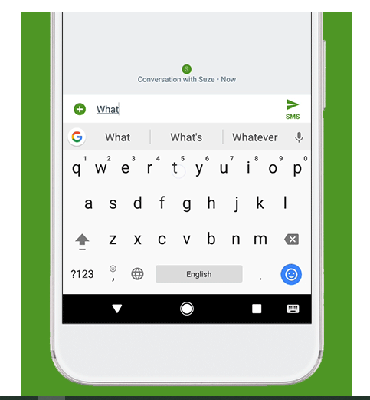
Example

Slide 6

Language modelling
A model that computes either of these:
Probability of a sentence ( P(W) ) or Probability of an upcoming word (P(w_{n}|w₁,w₂…w_{n-1})) is called a language model.
Simply we can say that
A language model learns to predict the probability of a sequence of words.

Slide 7


Language Models
1.Machine Translation:
Machine translation system is used to translate one language to another language .For example Chinese to English or German to English etc.

Slide 8
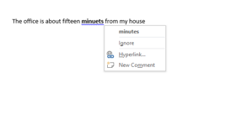
Continued..
2.Spell correction
P(about fifteen minutes from) > P(about fifteen minuets from)

Slide 9

3.Speech Recognition
Speech recognition is the ability of a machine or program to identify words and phrases in spoken language and convert them to a machine-readable format.

Slide 10

How to build a language model
Recall the definition of conditional probabilities
p(B|A) = P(A,B)/P(A) Rewriting: P(A,B) = P(A)P(B|A)
More variables:
P(A,B,C,D) = P(A)P(B|A)P(C|A,B)P(D|A,B,C)
The Chain Rule in General
P(x₁,x₂,x₃,…,x_{n}) = P(x₁)P(x₂|x₁)P(x₃|x₁,x₂)…P(x_{n}|xn-1,xn-2……,x₁)

Slide 11
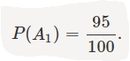
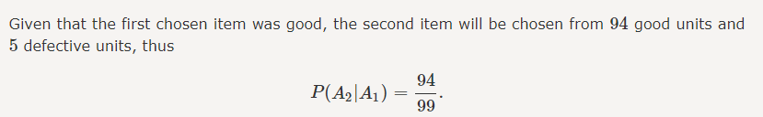
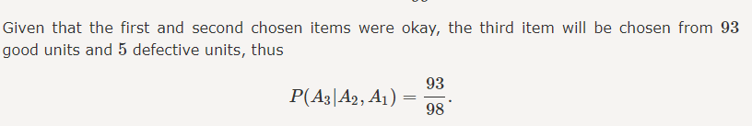
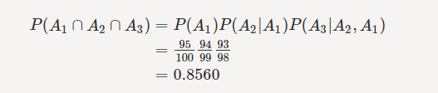
Example
In a factory there are 100 units of a certain product, 5 of which are defective. We pick three units from the 100 units at random. What is the probability that none of them are defective?
Let Ai as the event and i=1,2,3

Slide 12
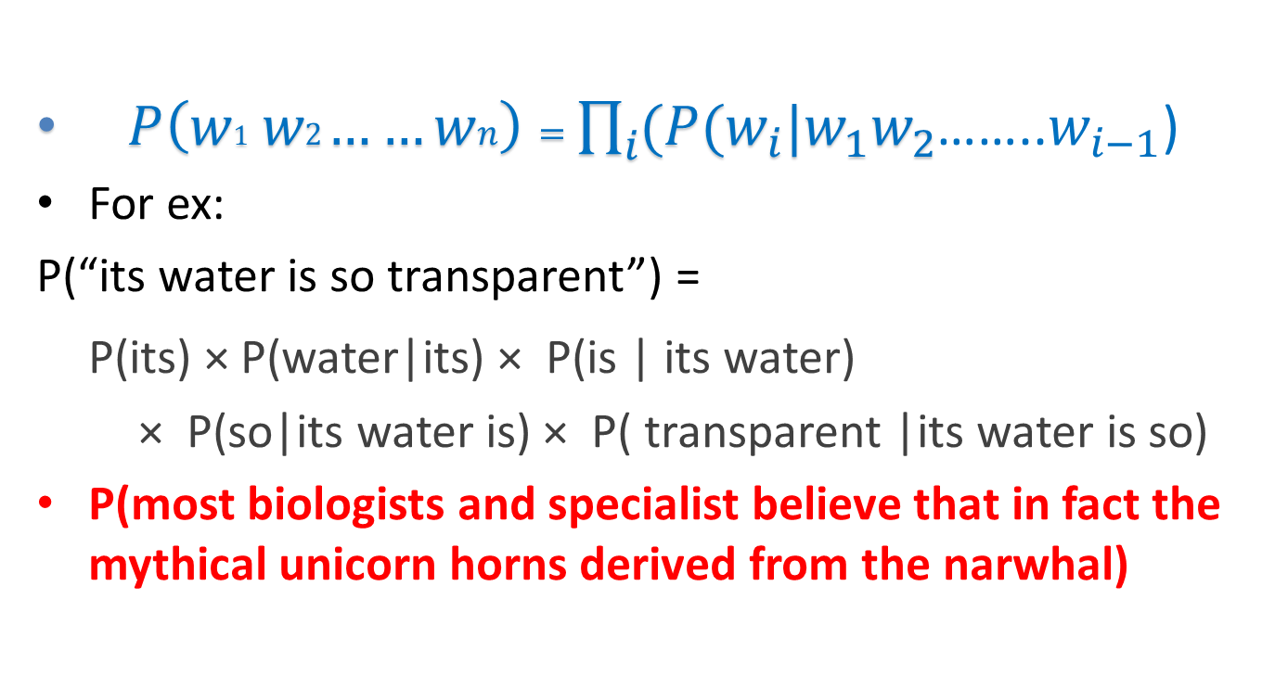
The Chain Rule applied to compute joint probability of words in sentence
$P\left(w1 w2……wn\right)=\prod_{i}{(P(w_{i}|w_{1}w_{2}}$……..$w_{i−1}$)
For ex:
P(“its water is so transparent”) =
P(its) × P(water|its) × P(is | its water)
× P(so|its water is) × P( transparent |its water is so)
P(most biologists and specialist believe that in fact the mythical unicorn horns derived from the narwhal)

Slide 13

Markov Assumption
Simplifying assumption:
limit history of fixed number of wordsN1
or
Andrei Markov

Slide 14
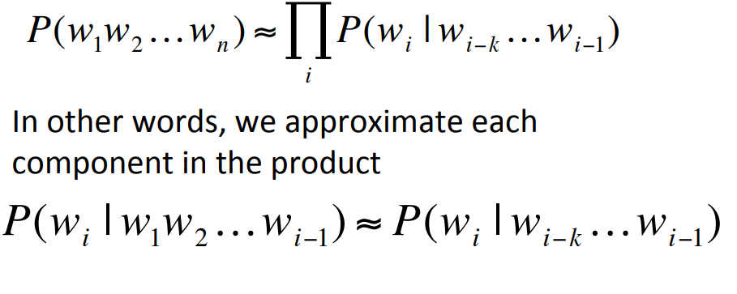
Markov Assumption

Slide 15
N -Gram Language models

Slide 16
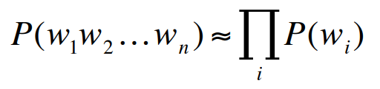
N-gram Language models
N gram is a sequence of tokens(words)
Unigram language model(N=1 )
Example:
P(I want to eat Chinese food)≈ P(I)P(want) P(to)P(eat)P(Chinese)P(food)

Slide 17
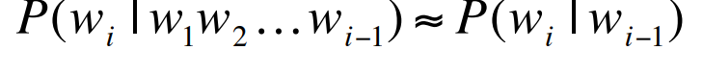
Bigram model
N=2
Example:
P(I want to eat Chinese food)≈ P(I|<start>) P(want|I) P(to|want) P(eat|to) P(Chinese|eat) P(food|Chinese)
P(<end>|food)

Slide 18
N-gram models
We can extend to trigrams, 4-grams, 5-grams
Advantages
no human supervision, easy to extend to more data, allows querying about open-class relations,
Disadvantage:
In general this is an insufficient model of language
because language has long-distance dependencies:
“The computer(s) which I had just put into the machine room on the fifth floor is (are) crashing.”

Slide 19
Estimating N-gram Probabilities

Slide 20
Estimating bigram probabilities
Estimating the probability as the relative frequency is the maximum likelihood estimate (or MLE ), because this value makes the observed data maximally likely
The Maximum Likelihood Estimate

Slide 21
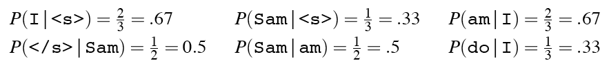
An example
<s> I am Sam </s>
<s> Sam I am </s>
<s> I do not like green eggs and ham </s>

Slide 22

Evaluation
Evaluation

Slide 23
How good is our model?
Does our language model prefer good sentences to bad ones?
Assign higher probability to “real” or “frequently observed” sentences
Than “ungrammatical” or “rarely observed” sentences?
We train parameters of our model on a training set.
We test the model’s performance on data we haven’t seen.
A test set is an unseen dataset that is different from our training set, totally unused.
An evaluation metric tells us how well our model does on the test set.

Slide 24
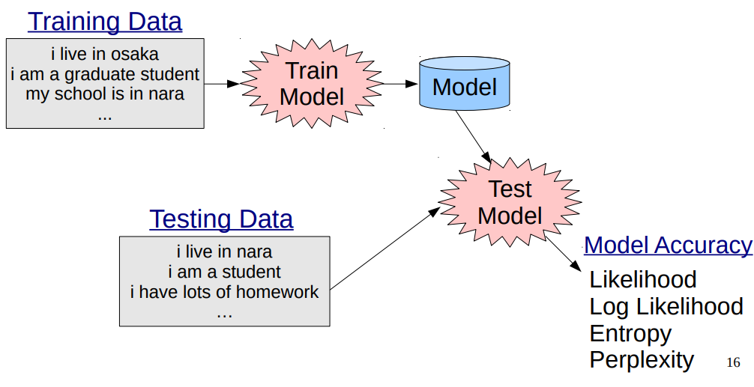
Experimental setup

Slide 25
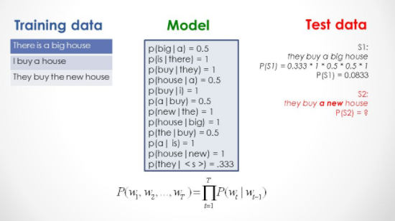
Example1:

Slide 26
Extrinsic evaluation of N-gram models
Best evaluation for comparing models A and B
Put each model in a task
spelling corrector, speech recognizer, MT system
Run the task, get an accuracy for A and for B
How many misspelled words corrected properly
How many words translated correctly
Compare accuracy for A and B

Slide 27
Difficulty of extrinsic (in-vivo) evaluation of N-gram models
Extrinsic evaluation
Time-consuming; can take days or weeks
Bad approximation
unless the test data looks just like the training data
So generally only useful in pilot experiments
So
Sometimes use intrinsic evaluation: perplexity

Slide 28
Intuition of Perplexity
The Shannon Game:
How well can we predict the next word?
I always order pizza with cheese and….
The president of India is……
I wrote a ……
Unigrams are terrible at this game. (Why?)
A better model of a text
is one which assigns a higher probability to the word that actually occurs
mushrooms 0.1
pepperoni 0.1
anchovies 0.01
….
fried rice 0.0001
….
and 1e-100

Slide 29
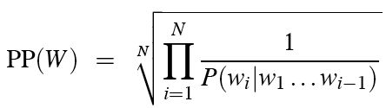
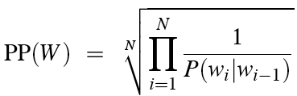
Perplexity
The best language model is one that best predicts an unseen test set
Gives the highest P(sentence)
Perplexity is the inverse probability of the test set, normalized by the number of words:
Chain rule:
For bigrams:
Minimizing perplexity is the same as maximizing probability

Slide 30
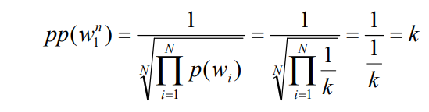
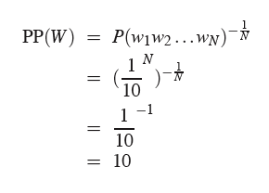
Perplexity as branching factor
Suppose we have vocabulary ok k word, and our model assigns probability 1/k to each word. for a sentence consisting of N random words:
Let’s suppose a sentence consisting of random digits
What is the perplexity of this sentence according to a model that assign P=1/10 to each digit?

Slide 31
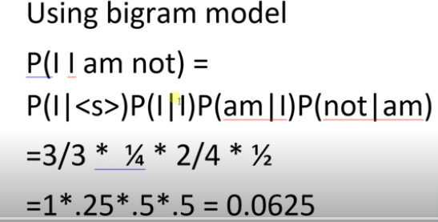
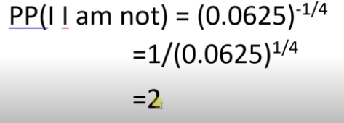
Example1

Slide 32
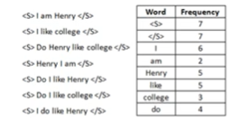
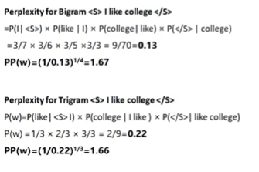
Example2

Slide 33
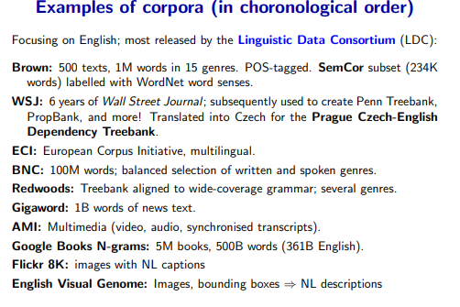
Corpora

Slide 34
Lower perplexity = better model
Training 38 million words, test 1.5 million words, WSJ
N-gram Order | Unigram | Bigram | Trigram
Perplexity | 962 | 170 | 109

Slide 35
Generalization and Zeros

Slide 36
The perils of overfitting
N-grams only work well for word prediction if the test corpus looks like the training corpus
In real life, it often doesn’t
We need to train robust models that generalize!
One kind of generalization: Zeros!
Things that don’t ever occur in the training set
But occur in the test set

Slide 37
Problems with simple MLE estimations
Training set:
… denied the allegations
… denied the reports
… denied the claims
… denied the request
P(“offer” | denied the) = 0
Test set
… denied the offer
… denied the loan

Slide 38
Zero probability bigrams
Bigrams with zero probability
mean that we will assign 0 probability to the test set!
And hence we cannot compute perplexity (can’t divide by 0)!

Slide 39
Laplace Smoothing(Add 1 smoothing)
Pretend we saw each word one more time than we did
Just add one to all the counts!
MLE estimate:
Add-1 estimate:

Slide 40
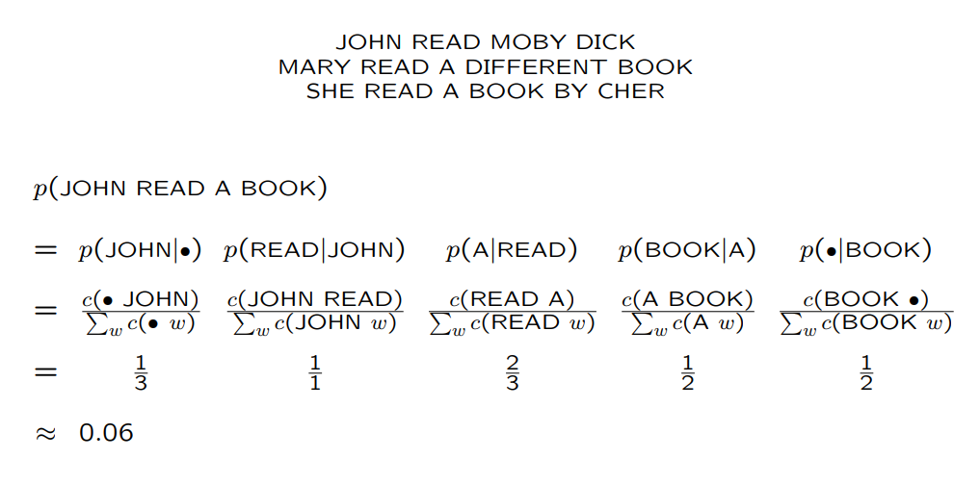
Example

Slide 41
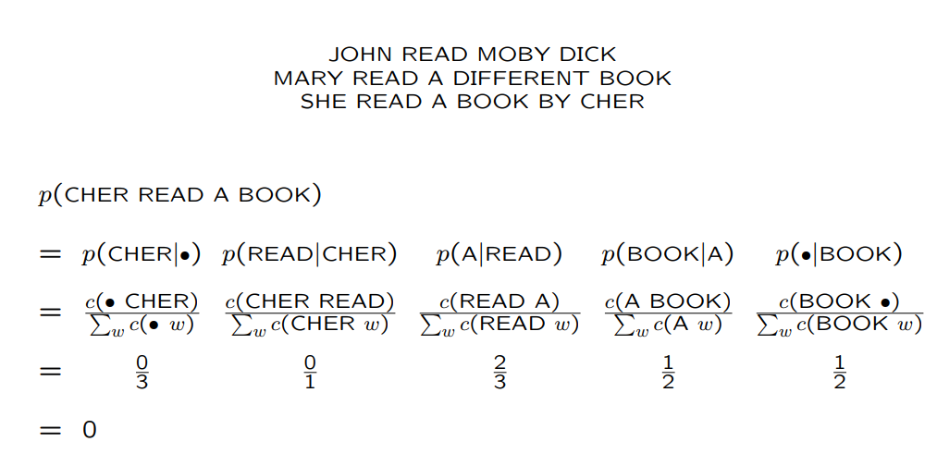

Slide 42
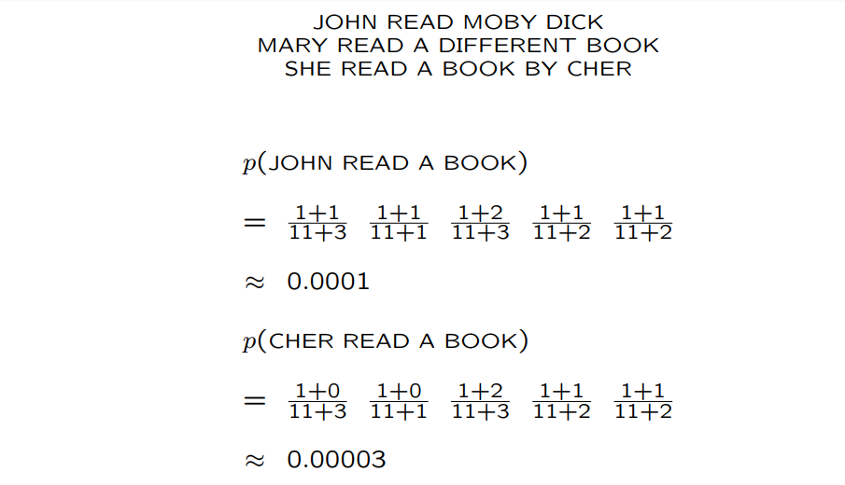
After Add-1 smoothing

Slide 43
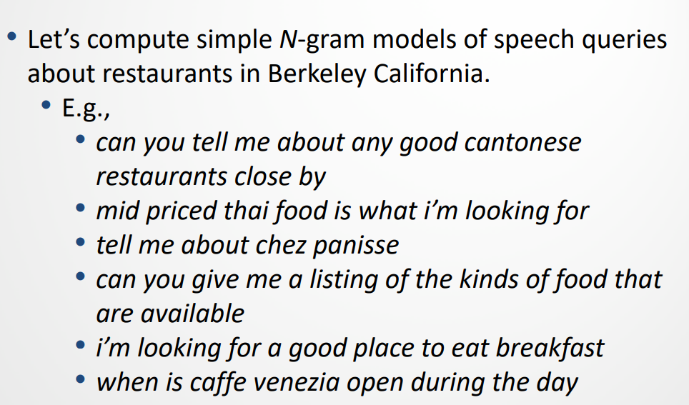
Berkeley Restaurant Project corpus

Slide 44
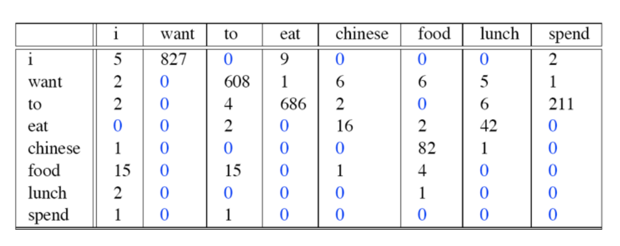
Raw Bigram Counts

Slide 45
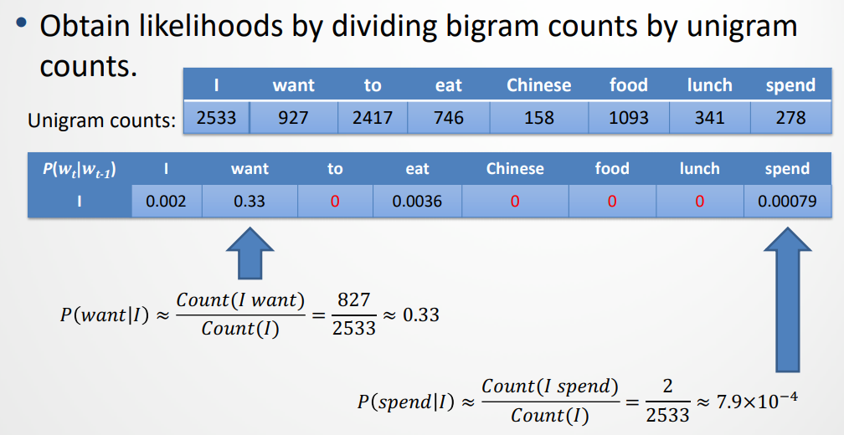
Converting to probabilities

Slide 46
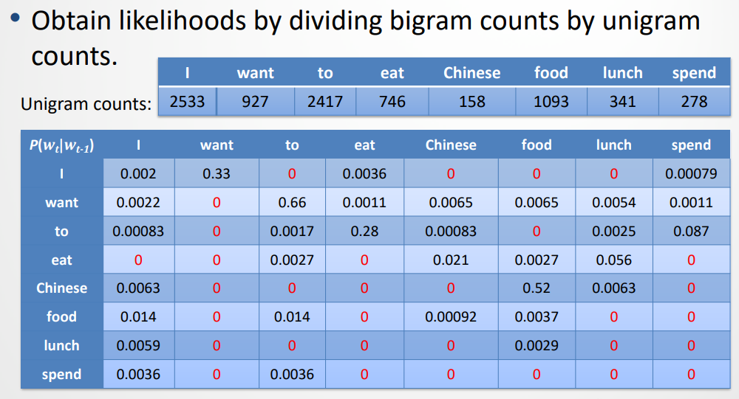
Contd…

Slide 47
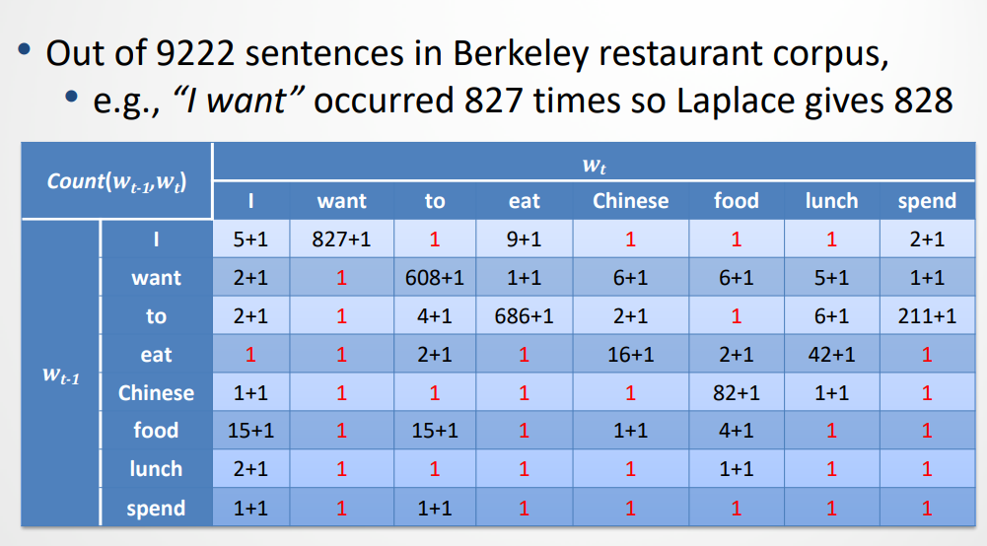
Berkeley Restaurant Corpus: Laplace smoothed bigram counts

Slide 48
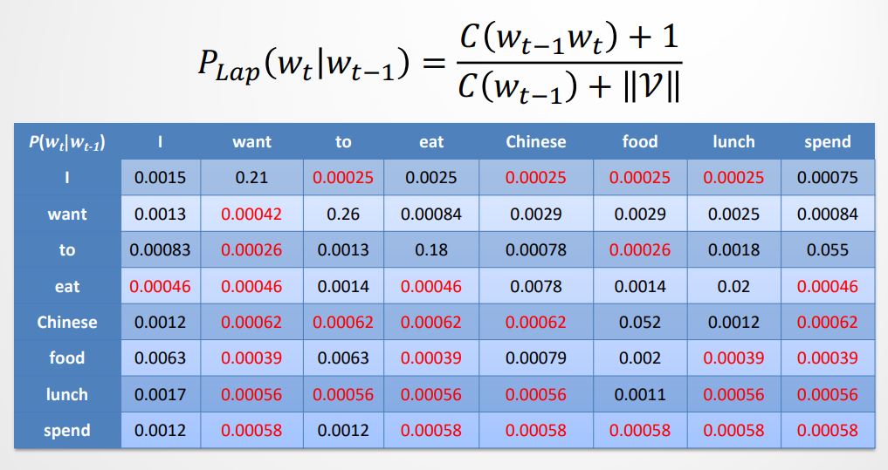
Laplace-smoothed bigrams
V=1446 in the Berkeley restaurant project corpus

Slide 49
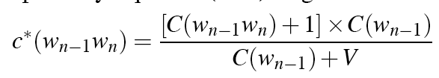
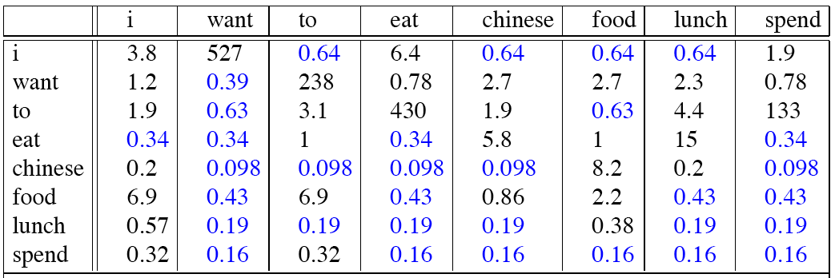
Reconstituted counts

Slide 50
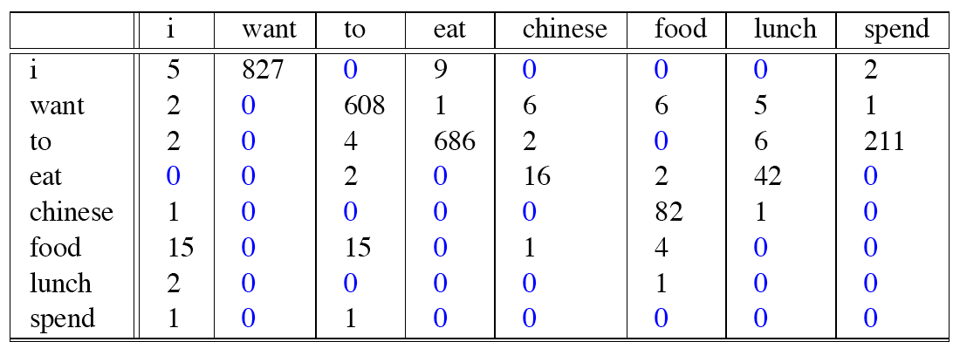
Compare with raw bigram counts
Notes:
C(want to) went from 608 to 238, P(to|want) from .66 to .26!
Discount d= c*/c
d for “chinese food” =.10!!! A 10x reduction

Slide 51
Add-1 estimation is a blunt instrument
So add-1 isn’t used for N-grams:
We’ll see better methods
But add-1 is used to smooth other NLP models
For text classification
In domains where the number of zeros isn’t so huge.

Slide 52
Backoff and Interpolation
Sometimes it helps to use less context
Condition on less context for contexts you haven’t learned much about
Backoff:
use trigram if you have good evidence,
otherwise bigram, otherwise unigram
Interpolation:
mix unigram, bigram, trigram
Interpolation works better

Slide 53
Linear Interpolation
Involves using different pieces of information to derive a probability
Simple interpolation

Slide 54
How to set the lambdas?
Use a held-out corpus
Choose λs to maximize the probability of held-out data:
Fix the N-gram probabilities (on the training data)
Then search for λs that give largest probability to held-out set:
Training Data
Held-Out Data
Test
Data

Slide 55
Unknown words: Open versus closed vocabulary tasks
If we know all the words in advanced
Vocabulary V is fixed
Closed vocabulary task
Often we don’t know this
Out Of Vocabulary = OOV words
Open vocabulary task
Instead: create an unknown word token <UNK>
Training of <UNK> probabilities
Create a fixed lexicon L of size V
At text normalization phase, any training word not in L changed to <UNK>
Now we train its probabilities like a normal word
At decoding time
If text input: Use UNK probabilities for any word not in training

Slide 56
Huge web-scale n-grams
How to deal with, e.g., Google N-gram corpus
Pruning
Entropy-based pruning
Only store N-grams with count > threshold.
Efficiency
Efficient data structures like tries
Bloom filters: approximate language models
Store words as indexes, not strings
Use Huffman coding to fit large numbers of words into two bytes

Slide 57
Smoothing for Web-scale N-grams
“Stupid backoff” (Brants et al. 2007)

Slide 58
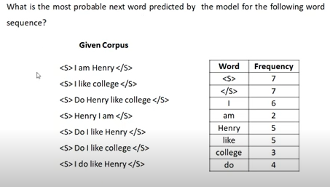
Exercise 1
1.<s> do? Two gram
2.<s>I like Hendry?
Two gram
3.<s> Do I like? Use trigram model
4.<s>Do I like college?
Four grams

Slide 59
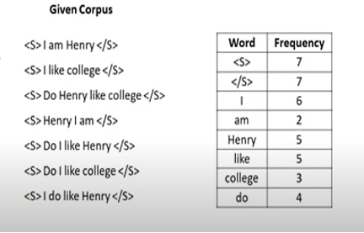
Exercise2
Which of the following sentence is better. Find out using bigram model
1.<S>I like college<S>
2.<S>Do I like Hendry<S>

Slide 60
Thank You… ☺
Q&A
Suggestions / Feedback

